Slide 1
Bank Credit Card Customer Churn Prediction Model

Slide 2
INTRODUCTION
Credit Card customer Attrition is a problem in Banking industry. Acquiring new customers is more expensive than retaining existing customers.
Use case is on detecting customers who are likely to attrite from a ML prediction model
Data
There are 10,000 rows and 20 columns
Exited – Y variable which predict the customer attrition

Slide 3
Model
Data
Data Cleansing and Feature Engineering
Exploratory Data Analysis
Train Data
Test Data
Model
Predict

Slide 4
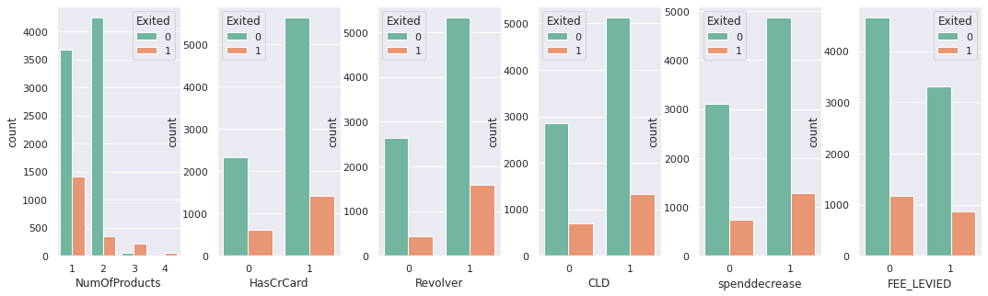
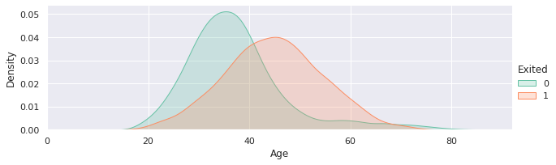
Exploratory Data Analysis
Customers with higher number of products has a higher chances to churn
40-60 Age group has a higher chance to churn

Slide 5
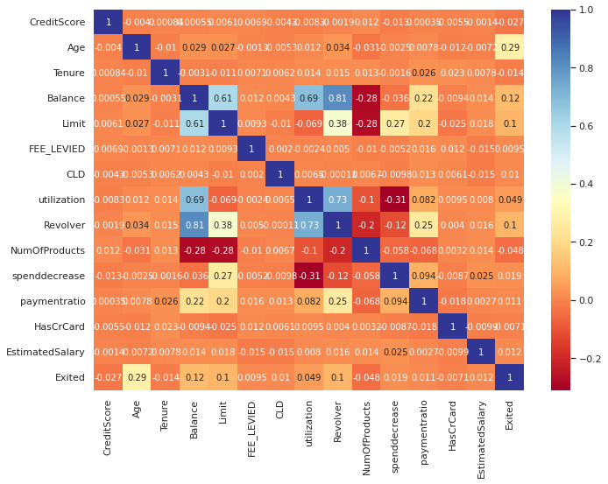
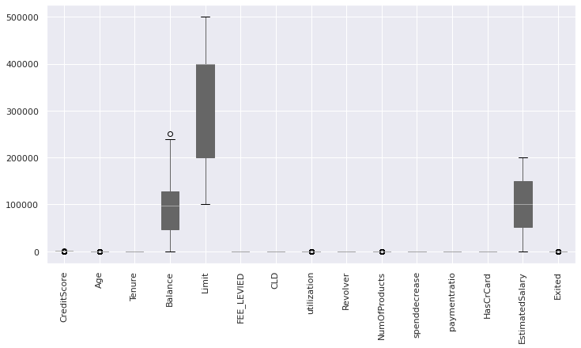
Box Plot and Heat Map

Slide 6
Accuracy of Models
Model | Accuracy
LGR | 0.7940
TC | 0.8270
RF | 0.8355
Comparing Models
Model | accuracy | precision | f1_score
LGR | 0.7940 | 0.000000 | 0.702827
TC | 0.8270 | 0.617857 | 0.813952
RF | 0.8355 | 0.679654 | 0.816782

Slide 7
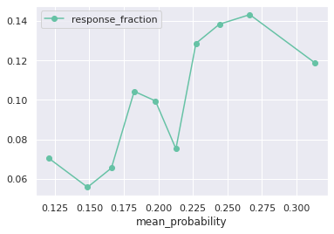
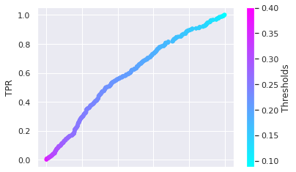
Calibration Curve

Slide 8
Conclusion
Supervised learning Algorithm was used
Logistic Regression Model, Tree Classifier and Random Forest Classifiers were used
Based on model performance Random Forest Classifier is the best model for prediction
To test and Train model the sample data was divided into 80% for Training and 20% for Testing

